Slide 1

Cybersecurity Company

Slide 2

Who we are?
Name: Octo Security
Logo:
Short description: Octo security is a cybersecurity company, which has such services as: monitoring projects for cyber incidents, penetration testing for founding vulnerabilities and development software for cyber security

Slide 3
Purposes and tasks of a business

Slide 4
What is main goal?
Secure business
Protected business from cyber incidents
Trustful relationships
Secure relationships

Slide 5
Services of the business

Slide 6
Red team
Penetration testing
System enumeration
Attack exploitation
OSINT
Blue team
Assistance with developing secure project
Monitoring of a IT system
Cyber Security risk management
Set-up network and so on

Slide 7
Business organization and legal form

Slide 8
Business organization and legal form
LLC for 2 years with self interpreneours and after change type to Diia City resident with GIG contracts for employees

Slide 9
Stages of legal registration and costs

Slide 10
Stages of legal registration and costs
Open LLC company – 1 500 ₴
Trade mark registration – 5 000 ₴

Slide 11
Form of taxation and accounting

Slide 12
Form of taxation
LLC
Income 18%
Military tax 1.5%
VAT 20%
Individual entrepreneur
Social security fee - 22% from minimal wage
5% personal income tax
Diia City
Corporate tax
9% exit capital tax
Labor taxes
5% personal income tax
Social security fee - 22% from minimal wage
Military tax 1.5%

Slide 13
Our Team

Slide 14

CEO - Quentin Tarantino
Strengths:
Think about business more than about something else
Experience:
Was CEO in 3 different successfully companies

Slide 15

CTO - Pamela Andersón
Strengths:
Overthinking
Experience:
9 years of development
3 years of management

Slide 16
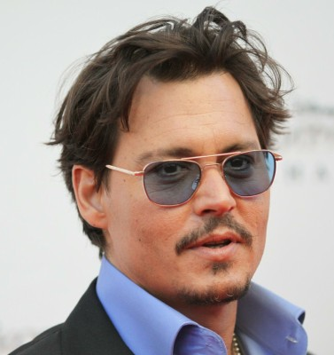
Penetration tester - Johnny Depp
Strengths:
Tryharder
Actually think outside the box
Experience:
Self-worker 5 years

Slide 17
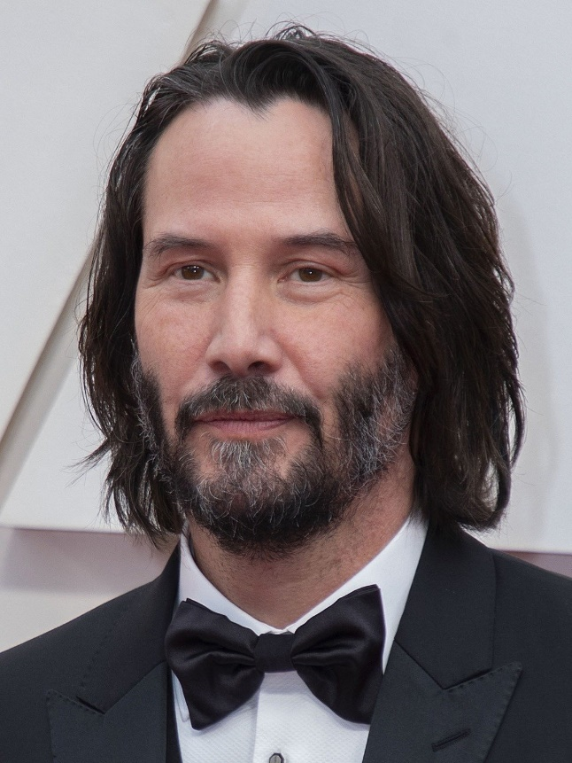
Software developer – Kiano Rews
Strengths:
Work more than 8 hours/day
Prefer new techonologies
Experience:
9 years of commercial development

Slide 18
Target Audience

Slide 19
Target audience
Type – online business, software, online products
Any online product, that has software and may be tested for hacker attack or any software that should be protected from cyber incident

Slide 20
Portrait of target audience
Job title
CEO
Founder / co-founder
CTO
Product owner
Product manager
Project has 100k+ users
Project on lunch step
Government projects
Financial projects

Slide 21
Marketing strategy and competitive advantages

Slide 22
Marketing strategy
Marketing strategy – B2B
Providing service for business
Market size
2022 – 153 600 000 000$
North America – 60 980 000 000$
2023 – more than 424 970 000 000$
North America – 67 770 000 000$
Planned for 2030 +13% for each year

Slide 23
Resources: for business starting

Slide 24
Possible sources of revenue
Penetration testing for business / application
White box testing
Grey box testing
Black box testing
Paid subscription for monitoring
OSINT
Set-up project, network and so on
Software development
Helpdesk
Cyber security trainings

